Slide 1
A MATHEMATICAL PUZZLE........
Presented at the Forum for Exchange of Mathematical Ideas
Pramada Ramachandran,
Assistant Professor,
Department of Mathematics,
St. Paul’s College, Kalamassery
07/04/2015

Slide 2
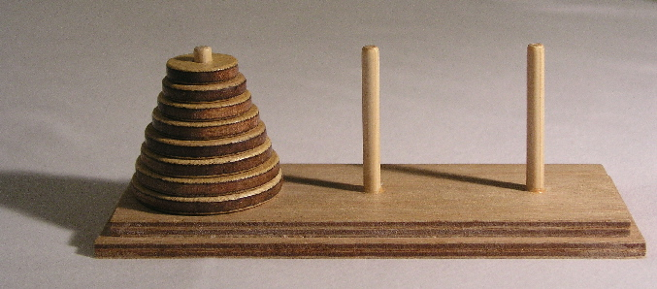
The Tower of Hanoi

Slide 3
What is the problem?
The objective of the puzzle is to move the entire stack to another rod, obeying the following simple rules:
Only one disk can be moved at a time.
Each move consists of taking the upper disk from one of the stacks and placing it on top of another stack i.e. a disk can only be moved if it is the uppermost disk on a stack.
No disk may be placed on top of a smaller disk.

Slide 4
The solution exists and has been found...........
The puzzle was invented by the French mathematician Édouard Lucas in 1883.
The minimum number of moves required to solve a Tower of Hanoi puzzle is 2^{n} - 1, where n is the number of disks

Slide 5
This puzzle contributed to the birth of.................
Combinatorics - it is a branch of Mathematics concerning the study of finite or countable Discrete Structures
Aspects of combinatorics include counting the structures of a given kind and size , deciding when certain criteria can be met, and constructing and analyzing objects meeting the criteria, finding "largest", "smallest", or "optimal" objects and studying combinatorial structures.
Combinatorial problems arise in many areas of pure mathematics, notably in Algebra, Topology and Geometry.
Combinatorics also has many applications in Optimization, Computer Science & Statistical Physics.

Slide 6
THANK YOU!!!!!!!!!!!!!!

